Slide 1
Basic Geography Terms

Slide 2
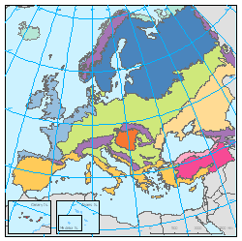
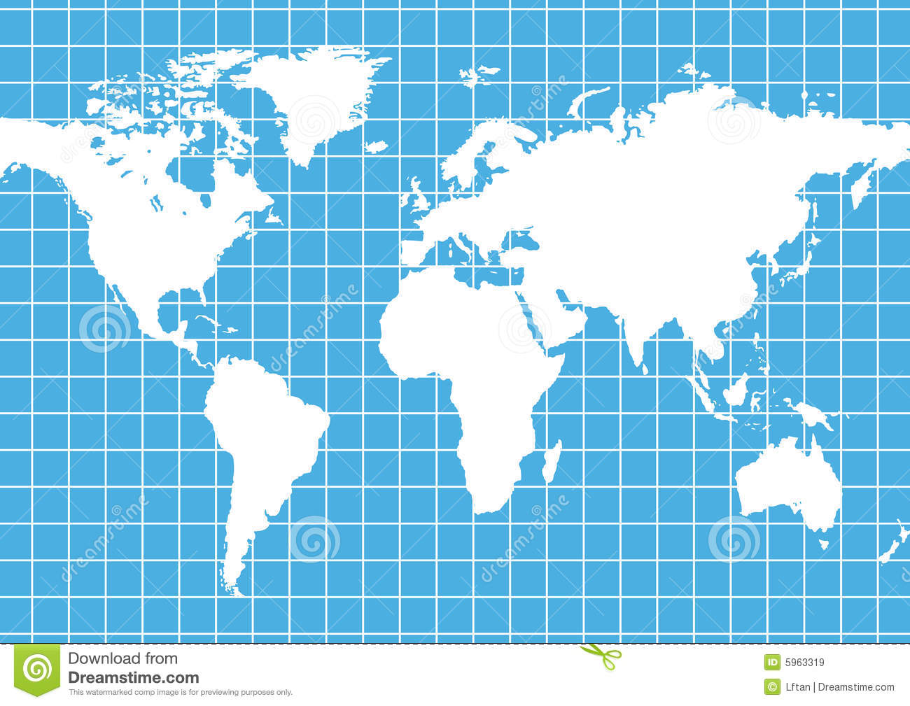
Grid- A grid consists of imaginary lines to help determine the location on the Earth.

Slide 3
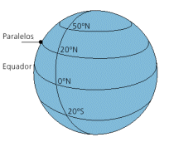
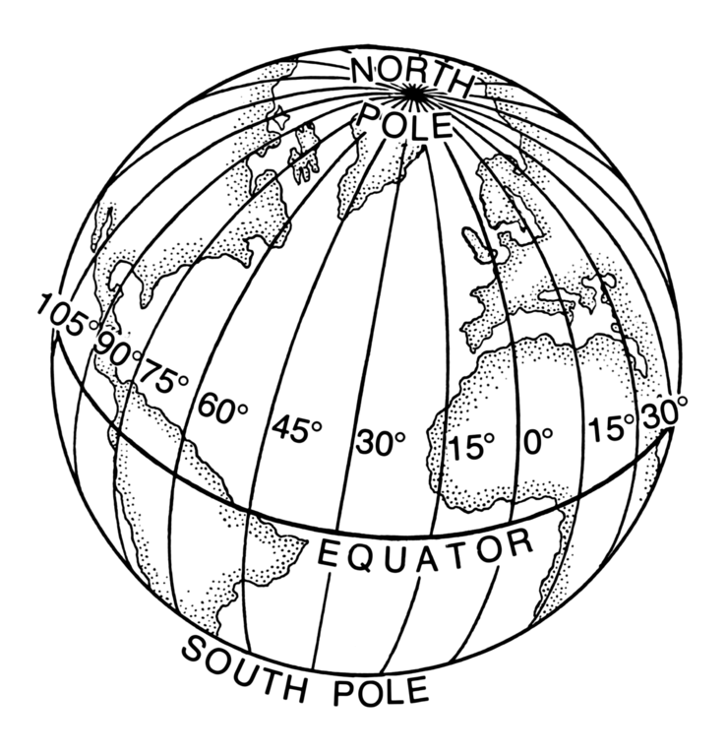
Latitude- Lines of latitude are imaginary lines that run from EAST to WEST. They are also called parallels.
Longitude- Lines of longitude are imaginary lines that run from NORTH to SOUTH. They are also called meridians.
Latitude
Longitude

Slide 4
Equator
An imaginary line at zero degrees that runs from EAST to WEST. It is a line of latitude.
Prime Meridian
The Prime Meridian is an imaginary line at zero degrees that runs from NORTH to SOUTH. It is a line of LONGITUDE.

Slide 5
Quick review!
Absolute Location
When a LATITUDE line intersects with a LONGITUDE line.
(40 degrees N, 80 degrees W)
Relative Location
The Perimeter Mall is near 285
Atlanta, GA is Southeast of Chattanooga, TN
Chattanooga, TN is Northwest of Atlanta, GA.

Slide 6
Let’s Practice
1. Which countries does the latitude line 40°N run through?
2. Which countries does the longitude line 70°E run through
3. What country is located at 45°N, 100°E?
4. What country is located at 30°N, 55°E?

