Slide 1
Geography of Europe

Slide 2
Essential Question: Where are the major physical features and nations of Europe located?
Standards:
SS6G8a. Locate on a world and regional political- physical map: the Danube River, Rhine River, English Channel, Mediterranean Sea, European Plain, the Alps, Pyrenees, Ural Mountains, Iberian Peninsula, and Scandinavian Peninsula.
SS6G8b. Locate on a world and regional political-physical map the countries of Belgium, France, Germany, Italy, Poland, Russia, Spain, Ukraine, and United Kingdom.
Notes:
Instructional Approach(s): The teacher should introduce the essential question and the standards that align to the essential question.

Slide 3
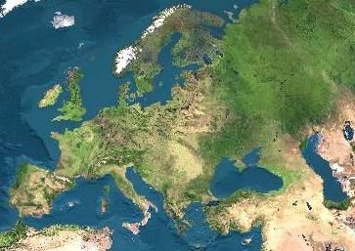
Satellite View of Europe
Notes:
Instructional Approach(s): The teacher should use the image to illustrate the continent of Europe. The teacher may want to ask the class or have students discuss together characteristics of Europe based on the map.

Slide 4
Size Comparison of Europe to the United States
Notes:
Instructional Approach(s): The teacher should use the image to illustrate the size of Europe in comparison to the United States.

Slide 5
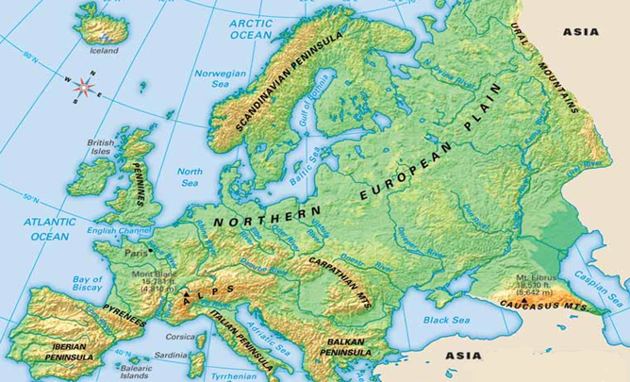
What do you notice is different about the physical features of Europe on your map?
Notes:
Instructional Approach(s): The teacher should pose the question on the slide to the class. In general, you want students to notice that there are some differences in the features on this map and the one they are using. Point out to students that we are only going to learn the specific physical features identified in the state standards; however, Europe has many more features than those identified in the standard.

Slide 6
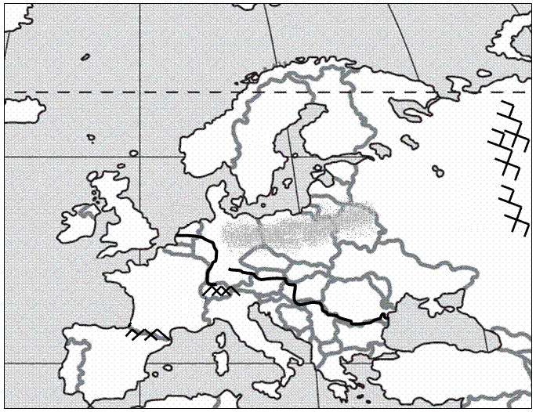
Mediterranean Sea
1
Notes:
Instructional Approach(s): The teacher should use the animated slide to identify the European physical feature on their map. The teacher may want to ask the class if anyone can identify the physical feature before clicking to show the answer.

Slide 7
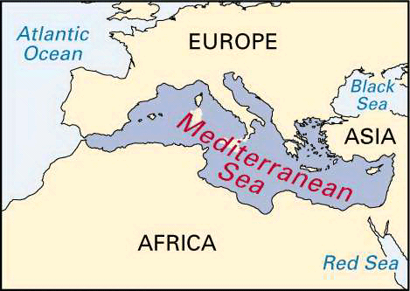
Notes:
Instructional Approach(s): The teacher should use the picture to illustrate the European physical feature.

Slide 8
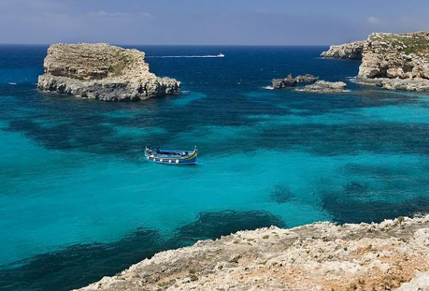
Notes:
Instructional Approach(s): The teacher should use the picture to illustrate the European physical feature.

Slide 9
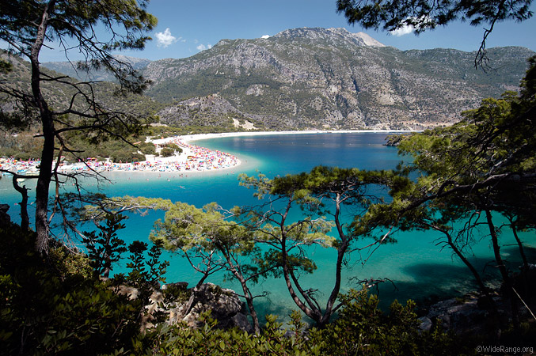
Notes:
Instructional Approach(s): The teacher should use the picture to illustrate the European physical feature.

Slide 10
Iberian Peninsula
2
Notes:
Instructional Approach(s): The teacher should use the animated slide to identify the European physical feature on their map. The teacher may want to ask the class if anyone can identify the physical feature before clicking to show the answer.

Slide 11
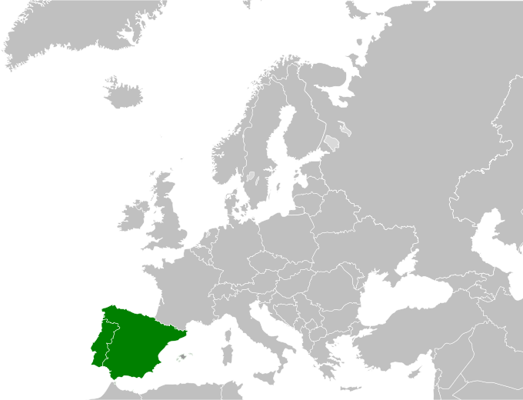
Notes:
Instructional Approach(s): The teacher should use the picture to illustrate the European physical feature.

Slide 12
Pyrenees [Mountains]
3
Notes:
Instructional Approach(s): The teacher should use the animated slide to identify the European physical feature on their map. The teacher may want to ask the class if anyone can identify the physical feature before clicking to show the answer.

Slide 13
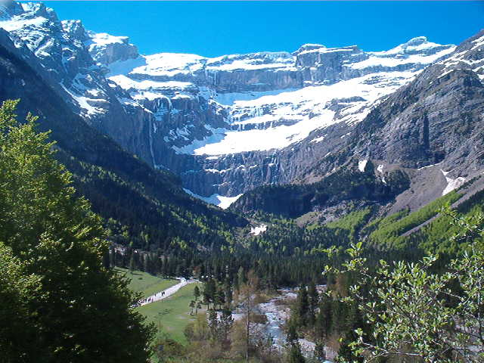
Notes:
Instructional Approach(s): The teacher should use the picture to illustrate the European physical feature.

Slide 14
Alps [Mountains]
4
Notes:
Instructional Approach(s): The teacher should use the animated slide to identify the European physical feature on their map. The teacher may want to ask the class if anyone can identify the physical feature before clicking to show the answer.

Slide 15
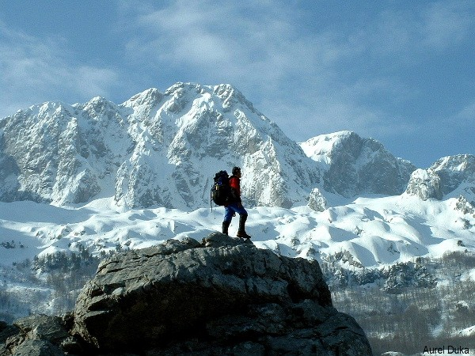
Notes:
Instructional Approach(s): The teacher should use the picture to illustrate the European physical feature.

Slide 16
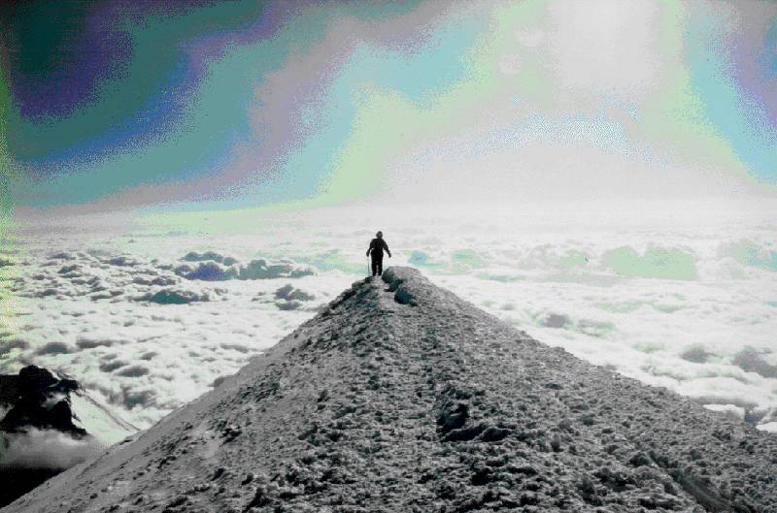
Mt. Blanc in the Alps
It’s the highest mountain in the Alps: 15,771 feet

Slide 17
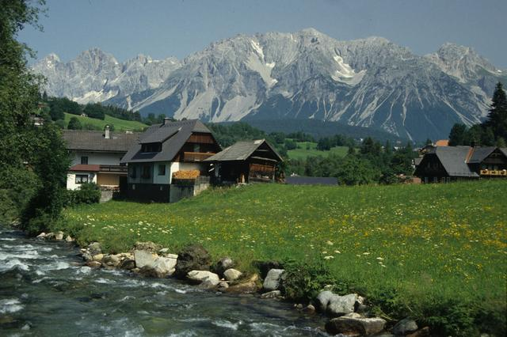
Notes:
Instructional Approach(s): The teacher should use the picture to illustrate the European physical feature.

Slide 18
English Channel
5
Notes:
Instructional Approach(s): The teacher should use the animated slide to identify the European physical feature on their map. The teacher may want to ask the class if anyone can identify the physical feature before clicking to show the answer.

Slide 19
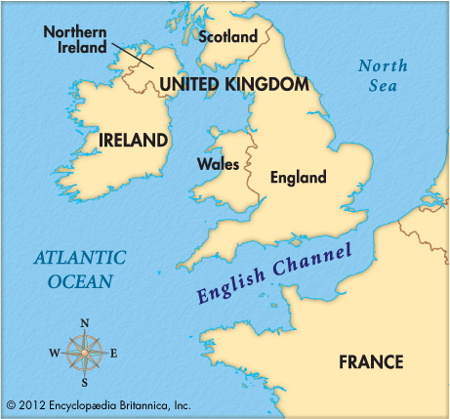
Notes:
Instructional Approach(s): The teacher should use the picture to illustrate the European physical feature.

Slide 20
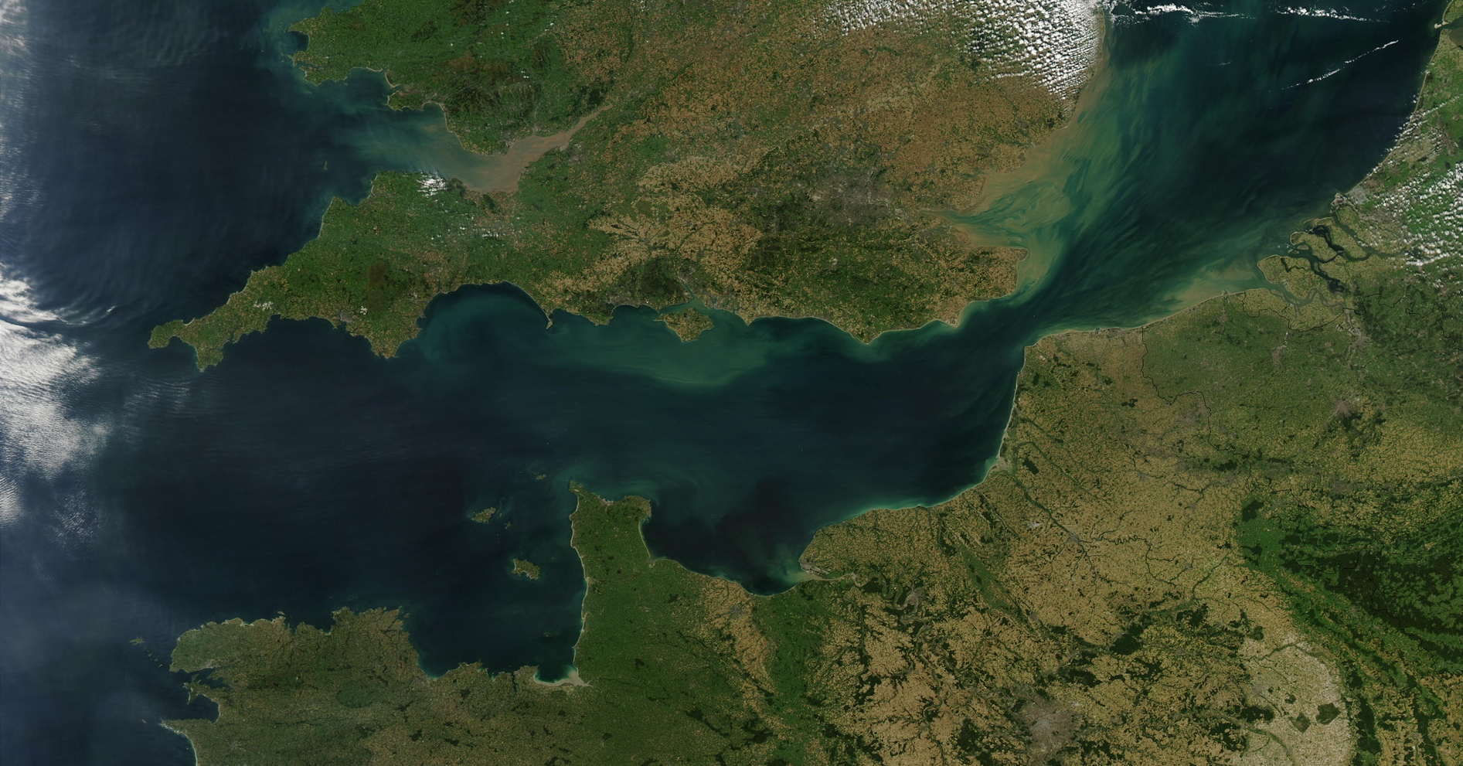
Notes:
Instructional Approach(s): The teacher should use the picture to illustrate the European physical feature.

Slide 21
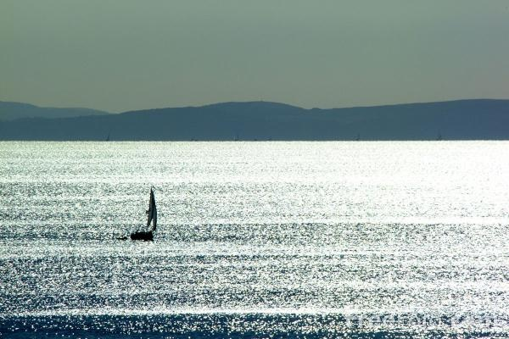
Notes:
Instructional Approach(s): The teacher should use the picture to illustrate the European physical feature.

Slide 22
Rhine River
6
Notes:
Instructional Approach(s): The teacher should use the animated slide to identify the European physical feature on their map. The teacher may want to ask the class if anyone can identify the physical feature before clicking to show the answer.

Slide 23
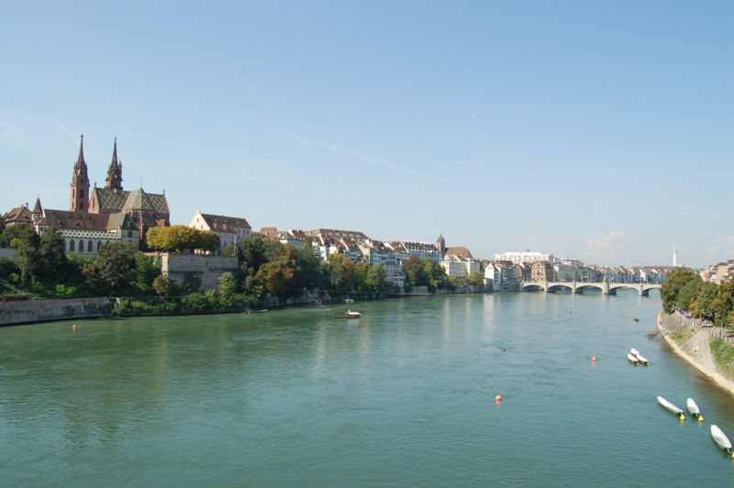
Notes:
Instructional Approach(s): The teacher should use the picture to illustrate the European physical feature.

Slide 24
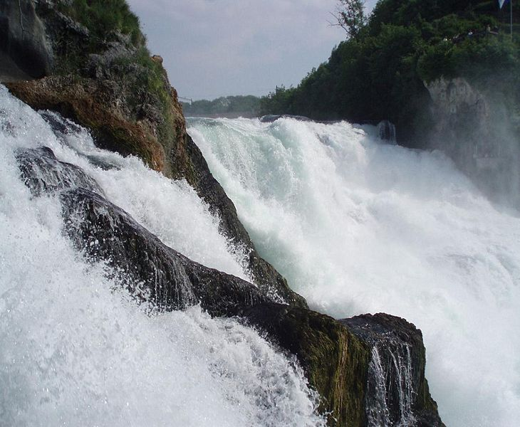
Notes:
Instructional Approach(s): The teacher should use the picture to illustrate the European physical feature.

Slide 25
European Plain
7
Notes:
Instructional Approach(s): The teacher should use the animated slide to identify the European physical feature on their map. The teacher may want to ask the class if anyone can identify the physical feature before clicking to show the answer.

Slide 26
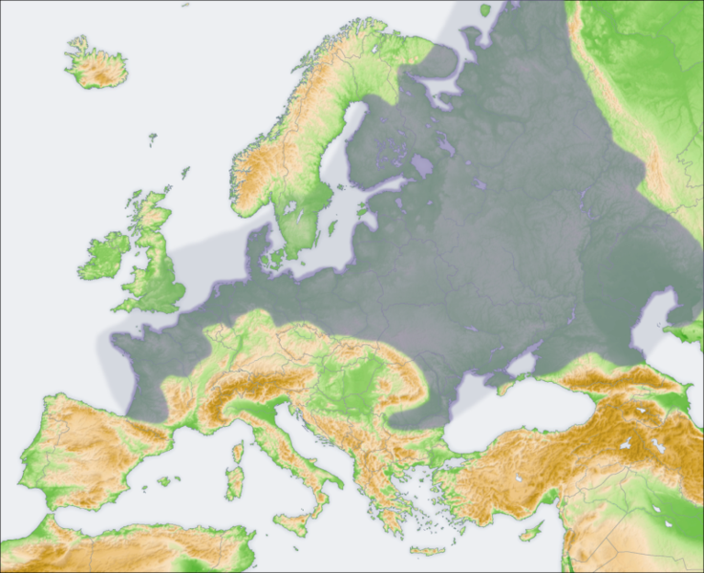
European Plain
Notes:
Instructional Approach(s): The teacher should use the picture to illustrate the European physical feature.

Slide 27
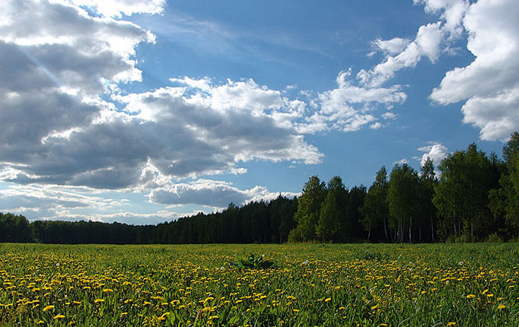
Notes:
Instructional Approach(s): The teacher should use the picture to illustrate the European physical feature.

Slide 28
Danube River
8
Notes:
Instructional Approach(s): The teacher should use the animated slide to identify the European physical feature on their map. The teacher may want to ask the class if anyone can identify the physical feature before clicking to show the answer.

Slide 29
Notes:
Instructional Approach(s): The teacher should use the picture to illustrate the European physical feature.

Slide 30
Ural Mountains
9
Notes:
Instructional Approach(s): The teacher should use the animated slide to identify the European physical feature on their map. The teacher may want to ask the class if anyone can identify the physical feature before clicking to show the answer.

Slide 31
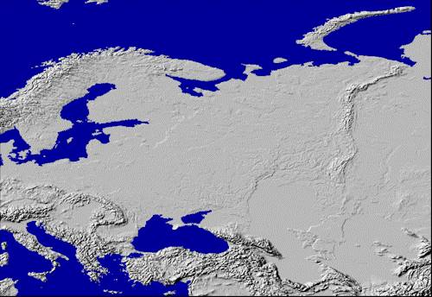
Ural Mountains: “The Great Divide”
1500 miles
It divides the European and Asian sections of Russia.

Slide 32
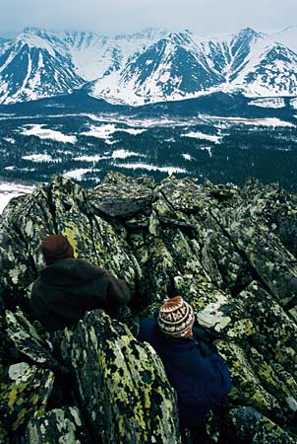
Notes:
Instructional Approach(s): The teacher should use the picture to illustrate the European physical feature.

Slide 33
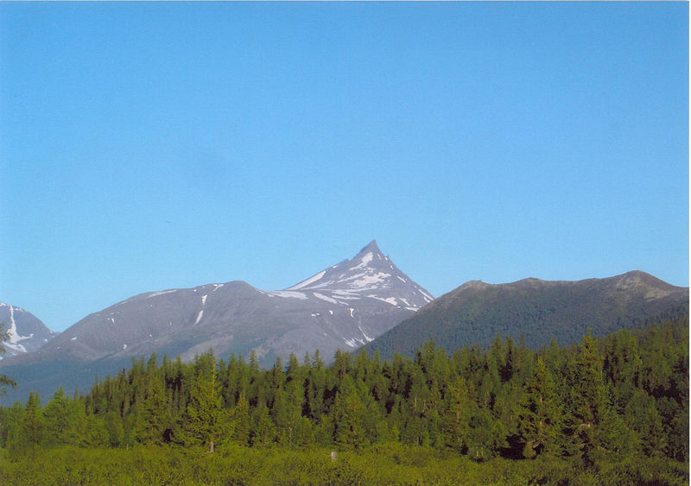
Notes:
Instructional Approach(s): The teacher should use the picture to illustrate the European physical feature.

Slide 34
Scandinavian Peninsula
10
Notes:
Instructional Approach(s): The teacher should use the animated slide to identify the European physical feature on their map. The teacher may want to ask the class if anyone can identify the physical feature before clicking to show the answer.

Slide 35
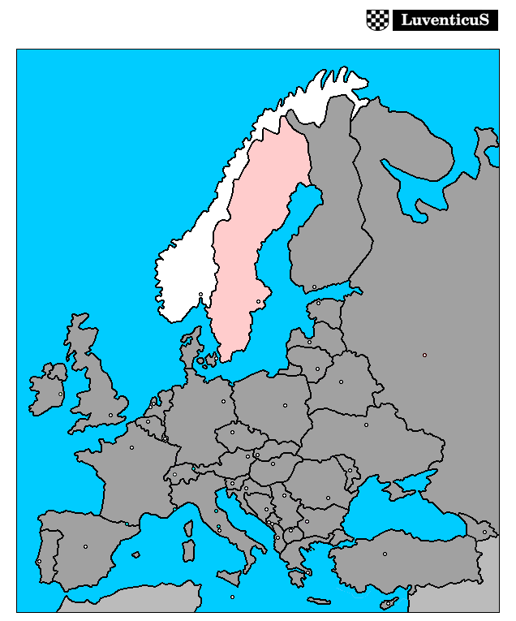
Notes:
Instructional Approach(s): The teacher should use the picture to illustrate the European physical feature.

Slide 36
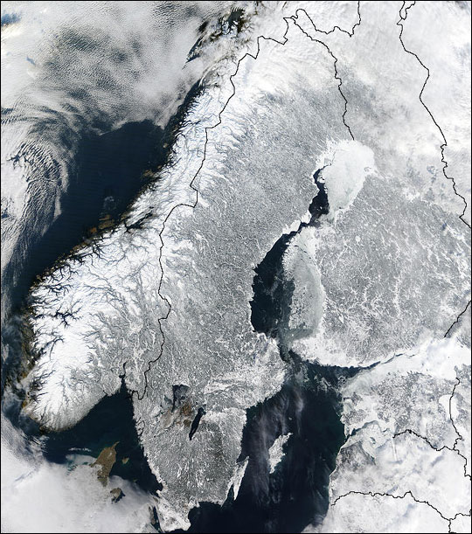
Notes:
Instructional Approach(s): The teacher should use the picture to illustrate the European physical feature.

Slide 37
There are two important oceans surrounding Europe that are not listed in the standards. However, knowing the location of these oceans is beneficial when describing the location of other physical features in Europe.

Slide 38
Arctic Ocean
11
Notes:
Instructional Approach(s): The teacher should use the animated slide to identify the European physical feature on their map. The teacher may want to ask the class if anyone can identify the physical feature before clicking to show the answer.

Slide 39
Atlantic Ocean
12
Notes:
Instructional Approach(s): The teacher should use the animated slide to identify the European physical feature on their map. The teacher may want to ask the class if anyone can identify the physical feature before clicking to show the answer.

Slide 40
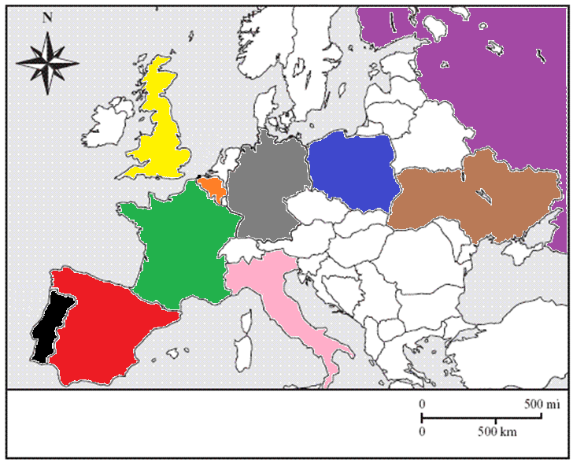
Political Map of Europe
We will identify the nations in color.
Notes:
Instructional Approach(s): The teacher should present the information on the slide.

Slide 41
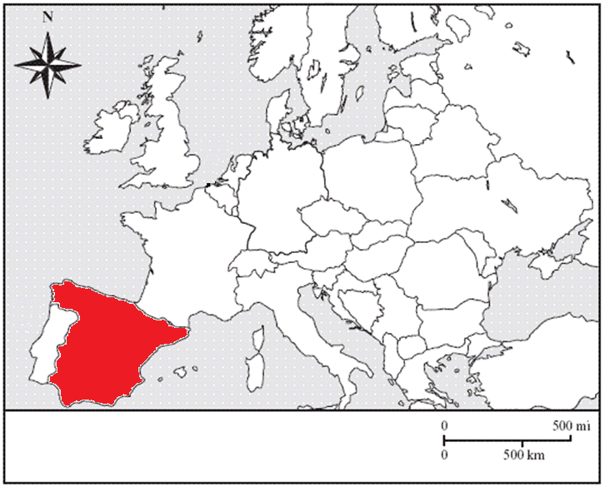
Spain
1
Notes:
Instructional Approach(s): The teacher should use the animated slide to identify the European country on their map. The teacher may want to ask the class if anyone can identify the country before clicking to show the answer.

Slide 42
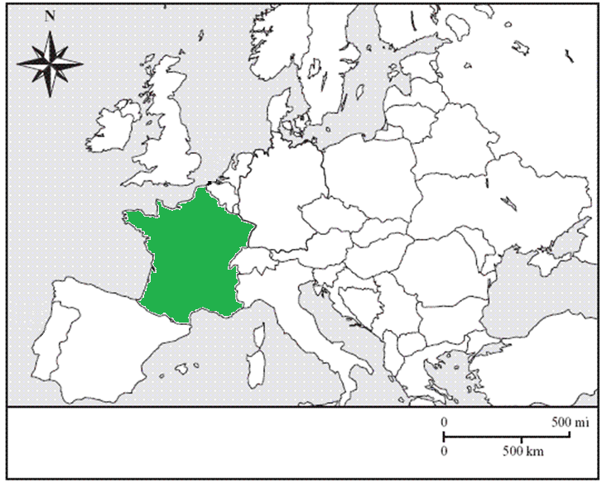
France
2
Notes:
Instructional Approach(s): The teacher should use the animated slide to identify the European country on their map. The teacher may want to ask the class if anyone can identify the country before clicking to show the answer.

Slide 43
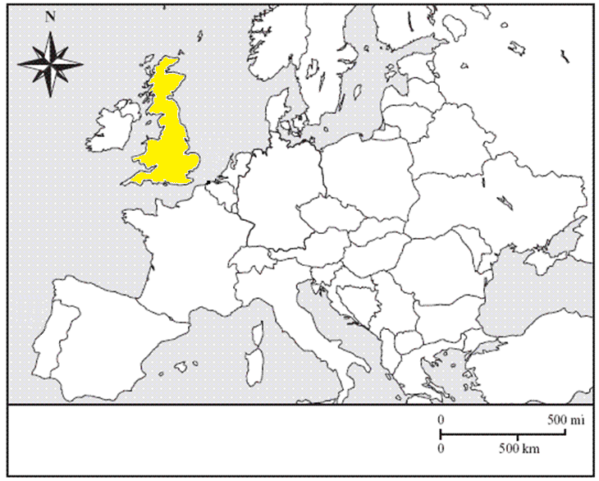
United Kingdom
3
Notes:
Instructional Approach(s): The teacher should use the animated slide to identify the European country on their map. The teacher may want to ask the class if anyone can identify the country before clicking to show the answer.

Slide 44
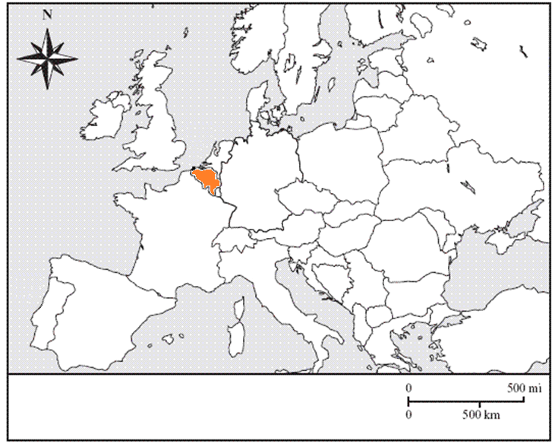
Belgium
4
Notes:
Instructional Approach(s): The teacher should use the animated slide to identify the European country on their map. The teacher may want to ask the class if anyone can identify the country before clicking to show the answer.

Slide 45
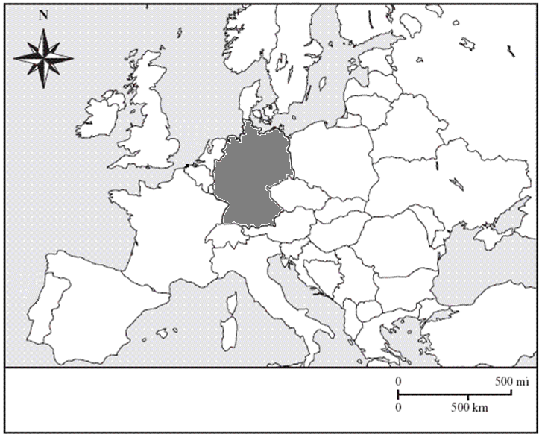
Germany
5
Notes:
Instructional Approach(s): The teacher should use the animated slide to identify the European country on their map. The teacher may want to ask the class if anyone can identify the country before clicking to show the answer.

Slide 46
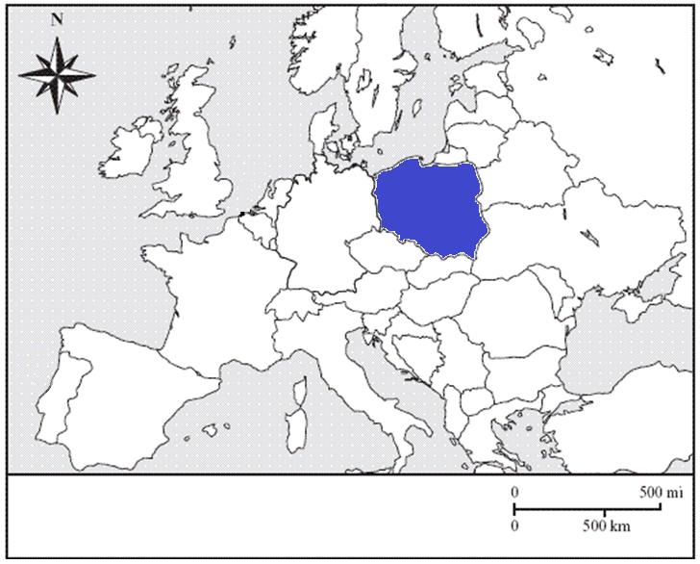
Poland
6
Notes:
Instructional Approach(s): The teacher should use the animated slide to identify the European country on their map. The teacher may want to ask the class if anyone can identify the country before clicking to show the answer.

Slide 47
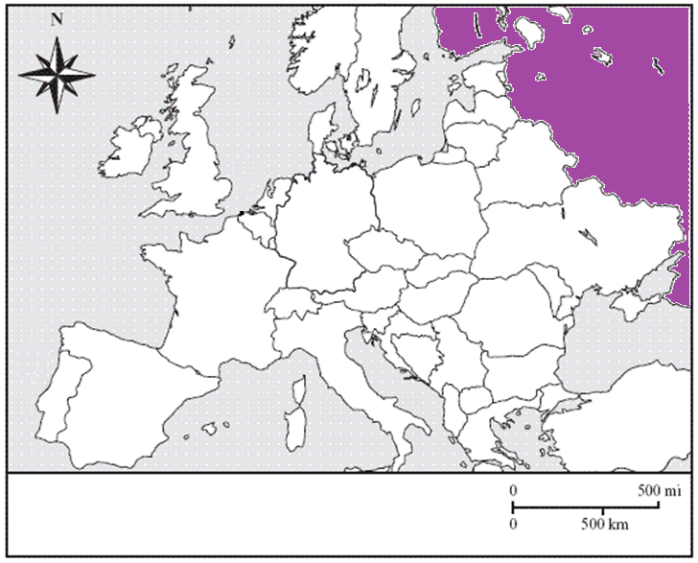
Russia
7
Notes:
Instructional Approach(s): The teacher should use the animated slide to identify the European country on their map. The teacher may want to ask the class if anyone can identify the country before clicking to show the answer.

Slide 48
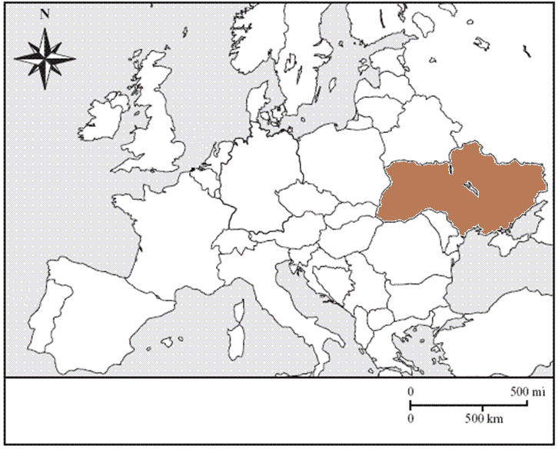
Ukraine
8
Notes:
Instructional Approach(s): The teacher should use the animated slide to identify the European country on their map. The teacher may want to ask the class if anyone can identify the country before clicking to show the answer.

Slide 49
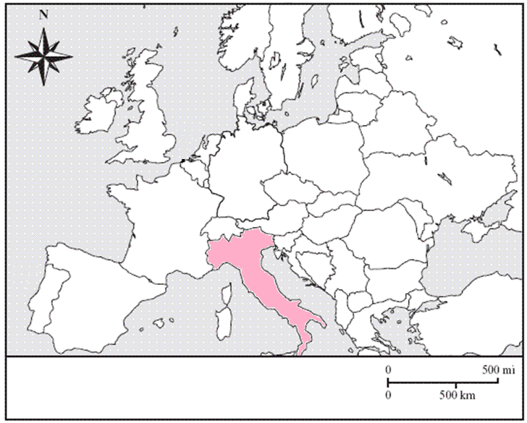
Italy
9
Notes:
Instructional Approach(s): The teacher should use the animated slide to identify the European country on their map. The teacher may want to ask the class if anyone can identify the country before clicking to show the answer.

Slide 50
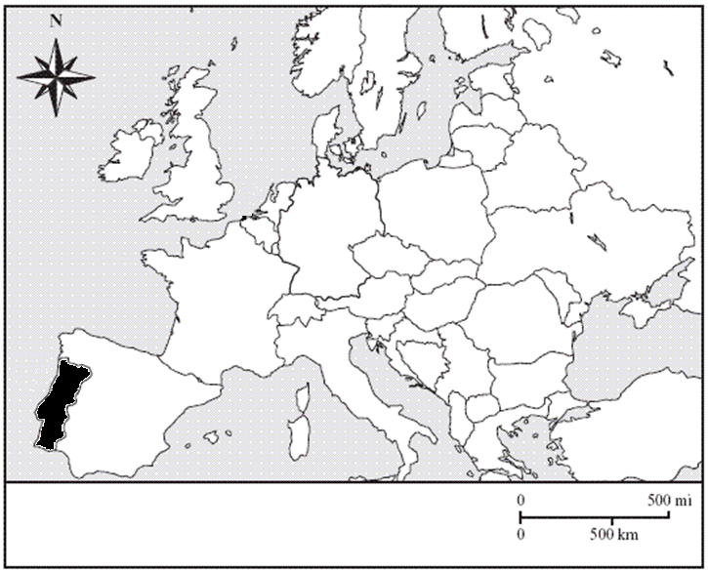
Portugal
10
Notes:
Instructional Approach(s): The teacher should use the animated slide to identify the European country on their map. The teacher may want to ask the class if anyone can identify the country before clicking to show the answer.

