Slide 1
What is the relationship between human capital, capital investment, and GDP?
SS6E3a-b, SS6E7a-b, SS6E10a-b, SS6G4c, SS6G11e, SS6G14b
Notes:
Instructional Approach(s): The teacher should introduce the essential question for the lesson

Slide 2
SS6E3a, SS6E7a, SS6E10a
Explain the relationship between investment in human capital (education and training) and gross domestic product (GDP)
SS6E3b, SS6E7b, SS6E10b
Explain the relationship between investment in capital (factories, machinery, and technology) and gross domestic product (GDP)
SS6G4c,SS6G11c, SS6G14b
Evaluate how the literacy rate affects the standard of living
Notes:
Instructional Approach(s): The teacher should introduce the standards that align to the essential question

Slide 3
Use the Factors of Economic Growth Graphic Organizer to take notes during the lesson.
Notes:
Instructional Approach(s): The teacher should give each student a copy of the Factors that Influence Economic Growth Graphic Organizer [linked on the resource page] to record important information during the lesson

Slide 4
How is Economic Growth Measured?
Economic growth in a country is measured by the country’s Gross Domestic Product (GDP) in one year
GDP = the total of goods and services produced in one year within a country
Notes:
Instructional Approach(s): The teacher should present the information on the slide while the students summarize the important information on their graphic organizer.

Slide 5
Gross Domestic Product (GDP)
GDP is a domestic measurement because it measures only what has been produced within a country – this does not include products that are imported.
It is much better for the economy of a country to produce its own goods and services [this increases the country’s GDP].
Notes:
Instructional Approach(s): The teacher should present the information on the slide while the students summarize the important information on their graphic organizer.

Slide 6
Gross Domestic Product
Measuring the GDP each year can:
Compare one country’s economy to another
Check a country’s economic progress
over time
Show if the economy is growing or not
Notes:
Instructional Approach(s): The teacher should present the information on the slide while the students summarize the important information on their graphic organizer.

Slide 7
Economic Growth
There are 4 main factors that influence economic growth within a country:
Investment in Human Capital
Investment in Physical Capital
Land [natural resources] available
Entrepreneurship
The presence or absence of these 4 factors determine the country’s Gross Domestic Product for the year
Notes:
Instructional Approach(s): The teacher should present the information on the slide to lead to the upcoming slides

Slide 8
Investment in Human Capital
Human Capital refers to the people who perform labor
When countries invest in Human Capital, they are providing education and/or training for the people who perform the labor
How would investing in human capital impact the GDP of a country?
Notes:
Instructional Approach(s): The teacher should present the information on the slide while the students summarize the important information on their graphic organizer.

Slide 9
Investment in Human Capital
Studies have shown that investment in the education and skills training of people relates to a higher GDP.
Education and the abilities it develops create a smarter and more productive workforce, which leads to greater economic growth.
Notes:
Instructional Approach(s): The teacher should present the information on the slide while the students summarize the important information on their graphic organizer.

Slide 10
Human Capital, Literacy Rate, and Standard of Living
There is a relationship between education levels and human capital in terms of people’s ability to produce income.
Literacy Rate is the number of people in an area that can read and write.
Standard of Living is a level of material comfort as measured by the goods, services, and luxuries available to an individual, group, or nation.
Notes:
Instructional Approach(s): The teacher should present the information on the slide while the students summarize the important information on their graphic organizer.

Slide 11
Standard of Living
What are some of the goods, services, and luxuries that someone with a high standard of living might enjoy that someone with a low standard of living might not enjoy?
Notes:
Instructional Approach(s): The teacher should pose the question on the slide to the class. The teacher can call on individual students or ask for volunteers to answer the question. The teacher should spend no more than 2 minutes discussing the question and answer with the class.

Slide 12
Standard of Living
Country | Puerto Rico | Haiti
Literacy Rate | 94.1% | 52.9 %
GDP per capita | $18,700 | $1,400
Life Expectancy | 78.58 | 57.56
Unemployment Rate | 12% | 40.6%
With a seat partner, discuss which country you think has the higher standard of living. Be able to explain your answer.
Notes:
Instructional Approach(s): Have students turn to a partner and discuss the question on the slide. Partners can be determined by the students or the teacher can provide more specific directions such as turn to the person directly in front/behind you or to the right/left of you, etc. It may be necessary to have a group of three if you have an uneven number of students. Do not allow more than 30 seconds to 1 minute of discussion time. The teacher should be walking around listening and redirecting discussions as needed. The teacher can briefly discuss student responses.

Slide 13
Human Capital, Literacy Rate, and Standard of Living
If you can read, you can learn. If you can learn, you can improve your work skills, and get a better job that pays a better salary. If you have a better salary, you can improve your standard of living.
A country that improves the literacy rate among its citizens will improve the standard of living within that country and improve its economy. Educated and skilled workers are an important factor in a country’s economic growth.
Notes:
Instructional Approach(s): The teacher should present the information on the slide while the students summarize the important information on their graphic organizer.

Slide 14
Human Capital
What is the current investment in your human capital?
Notes:
Instructional Approach(s): The teacher should pose the question to the class and briefly discuss some of their responses. Students should make the connection that their education is free and they are required to go to school so there is a strong investment in their human capital.

Slide 15
Investment in Capital [Physical]
Physical Capital refers to the factories, machinery, and technology used to produce goods and services.
When countries invest in Physical Capital, they are providing better facilities, resources and/or materials for the people who perform the labor
How would investing in physical capital impact the GDP of a country?
Notes:
Instructional Approach(s): The teacher should present the information on the slide while the students summarize the important information on their graphic organizer.

Slide 16
Investment in Physical Capital
Investment in physical capital relates to a higher GDP.
More advanced factories, machinery, and technology creates a more productive workforce, which leads to greater economic growth [higher GDP].
Notes:
Instructional Approach(s): The teacher should present the information on the slide while the students summarize the important information on their graphic organizer.

Slide 17
Natural Resources
Natural Resources are materials or substances that occur in nature and can be used for economic gain.
Notes:
Instructional Approach(s): The teacher should present the information on the slide while the students summarize the important information on their graphic organizer.

Slide 18
Natural Resources
With a seat partner, discuss the following question:
How does the presence or absence of natural resources impact a country’s economy [GDP]?
Notes:
Instructional Approach(s): Have students turn to a partner and discuss the question on the slide. Partners can be determined by the students or the teacher can provide more specific directions such as turn to the person directly in front/behind you or to the right/left of you, etc. It may be necessary to have a group of three if you have an uneven number of students. Do not allow more than 30 seconds to 1 minute of discussion time. The teacher should be walking around listening and redirecting discussions as needed. The teacher can briefly discuss student responses.

Slide 19
Natural Resources
Countries that have a lot of natural resources are able to use them to produce goods and services cheaper than a country that has to import natural resources.
Therefore, a country with a lot of natural resources USUALLY has a greater GDP than a country with little natural resources.

Slide 20
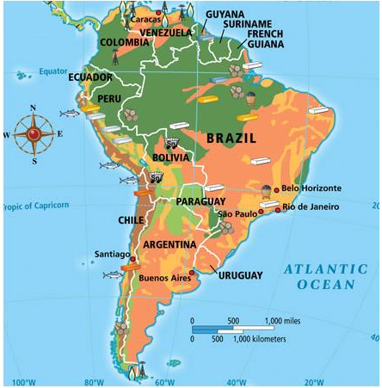
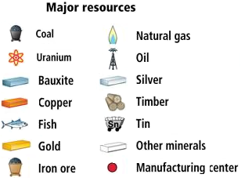
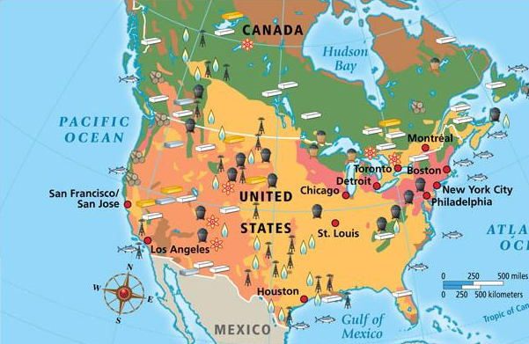
Comparing Natural Resources Worksheet
Notes:
Instructional Approach(s): Individually or with a partner, students compare two maps with natural resources and answer questions

Slide 21
Entrepreneurship
An Entrepreneur is someone who has an idea for a good or service and takes the risks to produce it.
Entrepreneurs are important because they come up with new ideas and use human, capital, and natural resources to bring their ideas to life and to the marketplace.
Notes:
Instructional Approach(s): The teacher should present the information on the slide while the students summarize the important information on their graphic organizer.

Slide 22
Entrepreneurship
It can be several things:
Starting your own business
Inventing something new
Changing the way something was previously done so that it works better
Notes:
Instructional Approach(s): The teacher should present the information on the slide while the students summarize the important information on their graphic organizer.

Slide 23
How does Entrepreneurship Influence Economic Growth?
Entrepreneurship creates jobs and reduces unemployment
Entrepreneurship encourages people to take risks, and in doing
so, create better materials,
products, technologies, etc.
The more entrepreneurs a country has, the higher the country’s GDP
Notes:
Instructional Approach(s): The teacher should present the information on the slide while the students summarize the important information on their graphic organizer.

