Slide 1
How does specialization encourage trade between countries?
SS6E2a, SS6E9a
Explain how specialization encourages trade between countries
Notes:
Instructional Approach(s): The teacher should introduce the essential question and the standard that aligns to the essential question.

Slide 2
Use the Factors of Voluntary Trade Graphic Organizer to take notes on Specialization during this presentation.
Notes:
Instructional Approach(s): The teacher should give each student a copy of the Factors of Voluntary Trade Graphic Organizer [linked on the resource page] to record important information during the lesson.

Slide 3
Specialization encourages voluntary trade and can be a positive factor in a country’s economy.
Specialization occurs when one country can produce a good or service at a lower opportunity cost than another country.
Notes:
Instructional Approach(s): The teacher should present the information on the slide while the students summarize the important information on their graphic organizer.

Slide 4
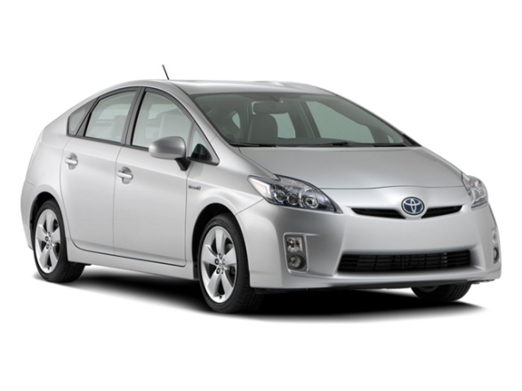
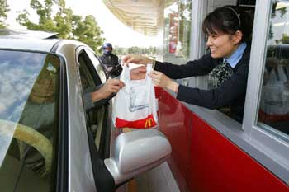
Vocabulary Review: With a seat partner determine whether the images represent a good or a service.
Goods
Services
Notes:
Instructional Approach(s): Have students turn to a partner and discuss the question on the slide. Partners can be determined by the students or the teacher can provide more specific directions such as turn to the person directly in front/behind you or to the right/left of you, etc. It may be necessary to have a group of three if you have an uneven number of students. Do not allow more than 30 seconds to 1 minute of discussion time. The teacher should be walking around listening and redirecting discussions as needed. The teacher should ask a few students to name a good or a service. When ready, click the mouse and only the “Goods” will appear as well as the title “Goods”. When you click the mouse again the “Goods” will disappear and the “Services” will appear.

Slide 5
How does specialization impact trade?
Specialization encourages trade between countries because a country can get what it needs at the lowest cost when it is produced by another country that specializes in that item.
Notes:
Instructional Approach(s): The teacher should present the information on the slide while the students summarize the important information on their graphic organizer.

Slide 6
Countries trade because no country has all of the resources it needs to provide for its people. Moreover, every country has different resources.
Notes:
Instructional Approach(s): The teacher should present the information on the slide

Slide 7
What are resources? With a seat partner, make a list of examples of resources. What happens when you do not have the resources you need?
Notes:
Instructional Approach(s): Teachers – this is not the time to teach students the actual names of different resources. Just brainstorm resources in general. Some examples students might mention: natural resources (more in-depth discussion of this in the next essential question), land, people, water, physical things, geographical features, etc. Discuss what resources they would need to survive and then what would they do if they did not have those resources. Do not spend more than 3-5 minutes discussing natural resources.

Slide 8
We have a global economy because countries trade with others from all over the world.
The global economy makes countries interdependent.
Notes:
Instructional Approach(s): The teacher should present the information on the slide

Slide 9
Voluntary Trade happens when both countries expect to gain from the trade. The “buyer” country receives goods and the “seller” country makes money.
Notes:
Instructional Approach(s): The teacher should present the information on the slide

Slide 10
International trade involves countries from all over the world engaging in voluntary trade.
Notes:
Instructional Approach(s): The teacher should present the information on the slide while the students record the important information on their graphic organizer.

Slide 11
Currency Exchange & International Trade
Exchange rates provide a procedure for determining the value of one’s currency in terms of another’s currency.
Notes:
Instructional Approach(s): The teacher should present the information on the slide while the students record the important information on their graphic organizer.

Slide 12
Sometimes countries set up Trade Barriers to restrict trade because they want to sell and produce their own goods.
Trade Barriers include:
Tariff
Quota
Embargo
Notes:
Instructional Approach(s): The teacher should present the information on the slide.

Slide 13
Trade Barrier: Tariff
Tariffs are taxes placed on imported goods.
Tariffs cause the consumer to pay a higher price for an imported item, increasing the demand for a lower-priced item produced domestically.
Notes:
Instructional Approach(s): The teacher should present the information on the slide while the students summarize the important information on their graphic organizer.

Slide 14
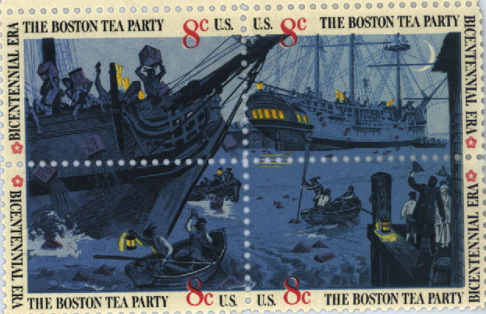
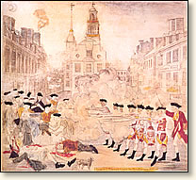
Trade Barriers: Tariffs
American Revolution
Notes:
Instructional Approach(s): The teacher can use the Boston Tea Party as an example of the use of tariffs.

Slide 15
Trade Barrier: Quotas
Quotas are limits on the amount of a good that can be imported into a country.
Quotas can cause shortages that cause prices to rise.
Notes:
Instructional Approach(s): The teacher should present the information on the slide while the students summarize the important information on their graphic organizer.

Slide 16
Trade Barrier: Embargos
Embargoes forbid trade with another country.
The United States had a trade embargo with South Africa during apartheid.
Notes:
Instructional Approach(s): The teacher should present the information on the slide while the students summarize the important information on their graphic organizer.

Slide 17
Trade Barriers: Embargos
Embargoes usually happen for political reasons. Because the United States does not want to support countries that may support terrorism, it has used embargos against Iran, Iraq, and Syria.
Notes:
Instructional Approach(s): The teacher should present the information on the slide while the students summarize the important information on their graphic organizer.

