Slide 1
How do location, climate, and natural resources influence Europe and its people?
Standards:
SS6G10a. Compare how the location, climate, and natural resources of the United Kingdom and Russia affect where people live and how they trade.
SS6G10b. Compare how the location, climate, and natural resources of Germany and Italy affect where people live and how they trade.
Notes:
Instructional Approach(s): The teacher should introduce the essential question and the standards that align to the essential question.

Slide 2
There are many factors that impact where people live and how they trade.
We are going to look at a few of these factors for four European countries.
Notes:
Instructional Approach(s): The teacher should present the information on the slide.

Slide 3
Compare the location, climate, and natural resources of
Germany and Italy.
Notes:
Instructional Approach(s): Put students in groups of 2-3. Have groups compare different factors to share with the class. Small groups can be student selected or teacher selected (differentiated if needed). Students should not be given more than 2-3 minutes to make comparisons. The teacher should briefly discuss student responses.

Slide 4
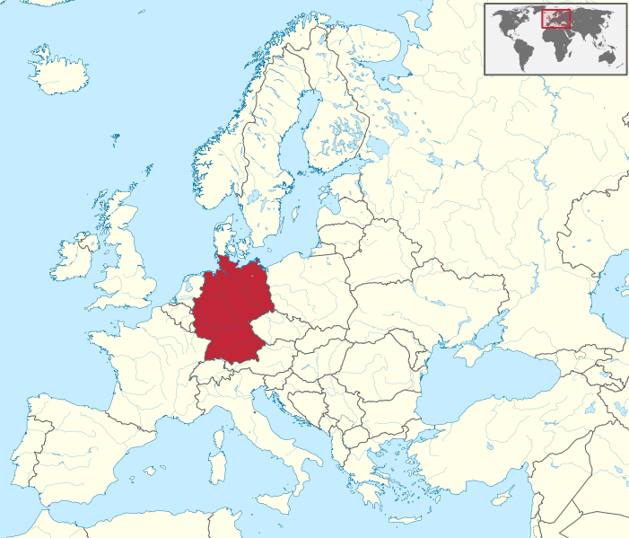
Germany
Notes:
Instructional Approach(s): Transition slide to move to the next country in Europe for discussion.

Slide 5
What are the advantages of Germany’s location?
Notes:
Instructional Approach(s): The teacher should pose the question to the class. The teacher can ask for volunteers or call on specific students to respond to the question.

Slide 6
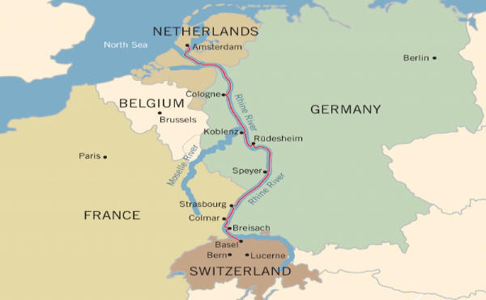
Germany’s Location
Due to Germany’s
location, its climate
is moderate
Germany is in central Europe, so it can trade easily with other
European countries.
Germany’s location is favorable for producing
many crops
The Rhine River allows Germany to transport goods to the North Sea
and the Atlantic Ocean
Notes:
Instructional Approach(s): The teacher should present the information on the slide while the students summarize the important information on their notes.

Slide 7
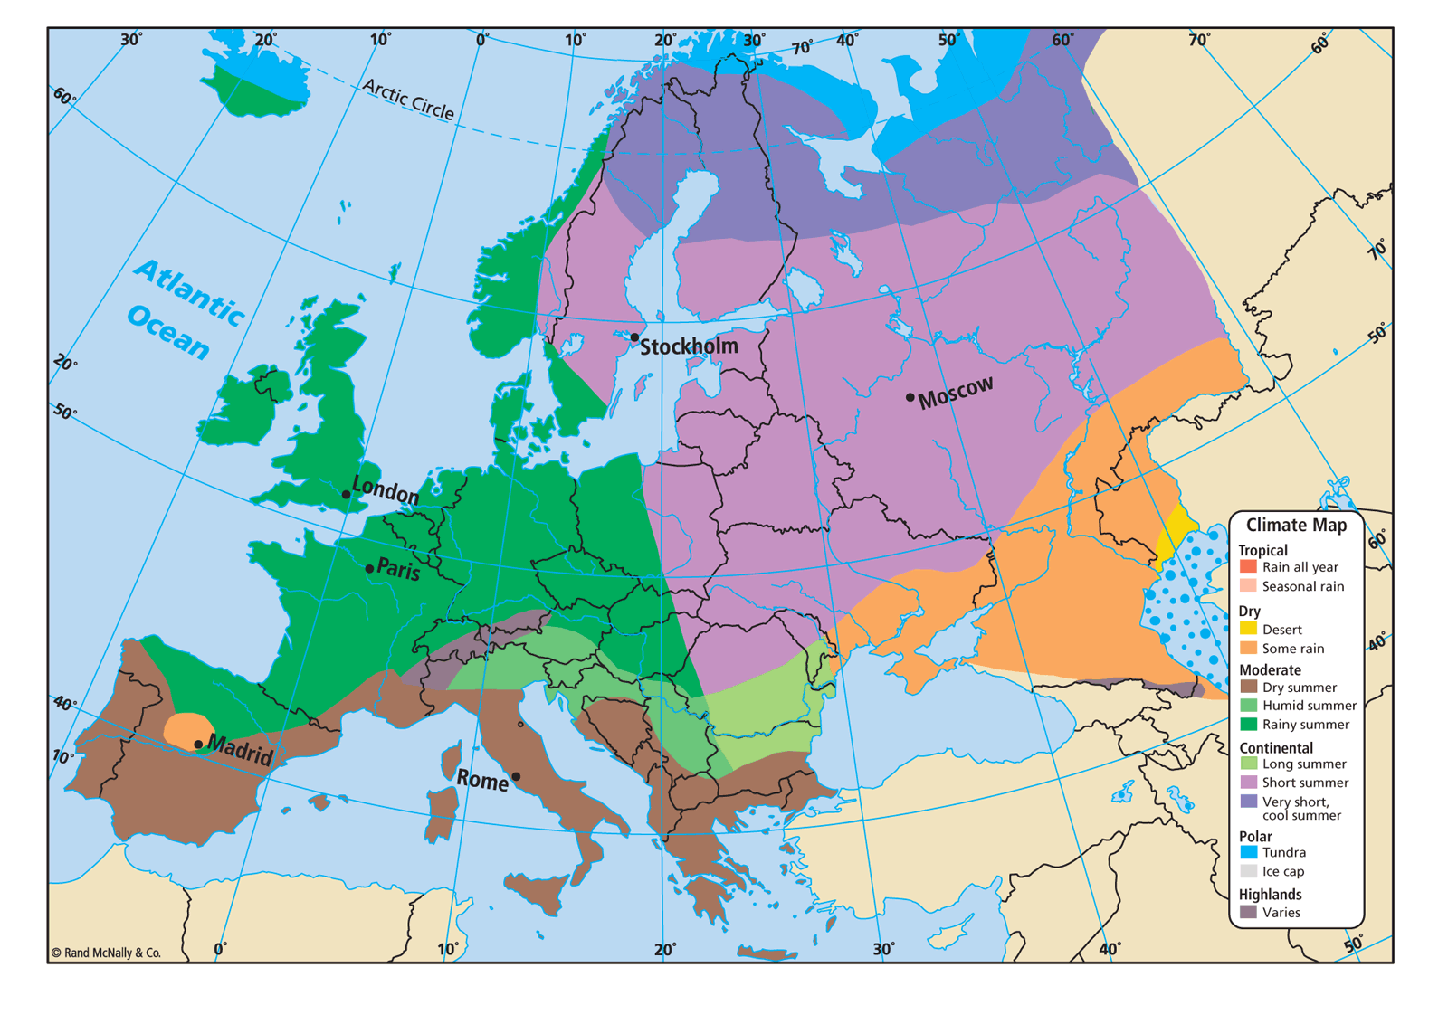
Germany’s
Climate
Germany
Germany’s climate is moderate with warm, mild summers and cool winters.
The climate is good for Germany’s agriculture industry, which uses about half of Germany’s land.
Notes:
Instructional Approach(s): The teacher should present the information on the slide while the students summarize the important information on their notes.

Slide 8
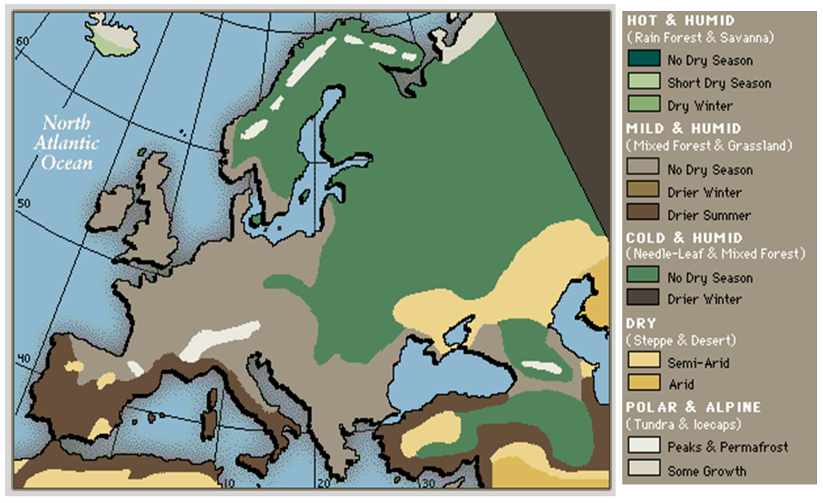
Notes:
Instructional Approach(s): The teacher should use the image on the slide to illustrate the country’s climate

Slide 9
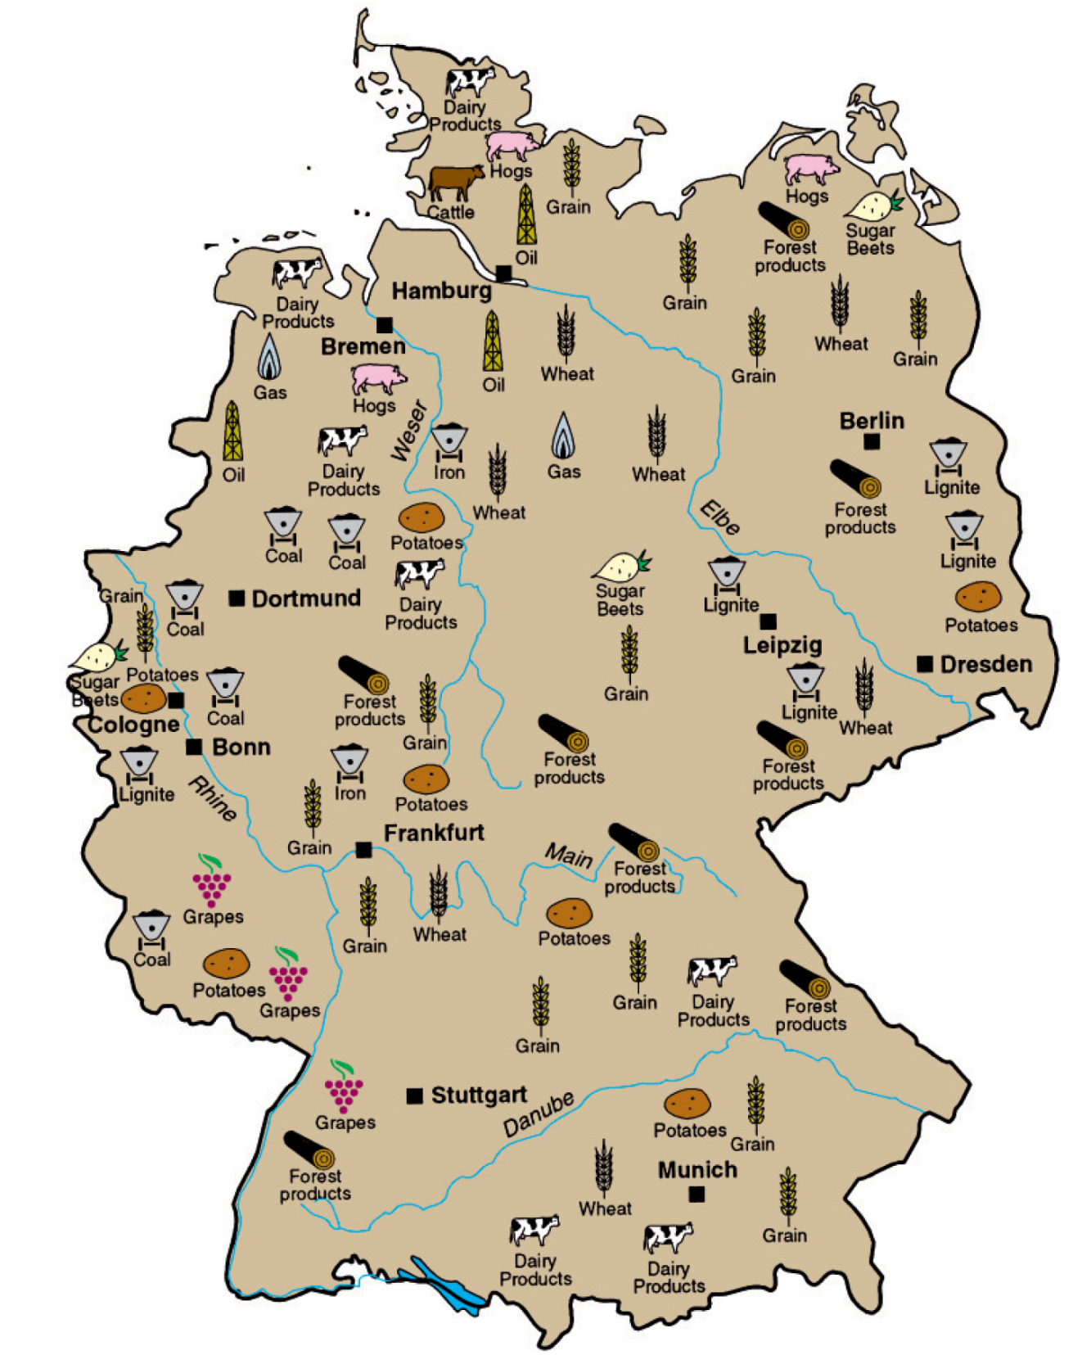
The map to the right illustrates Germany’s favorable climate for agriculture.
Notes:
Instructional Approach(s): The teacher should use the image on the slide to illustrate that Germany’s climate is very favorable for agriculture.

Slide 10
Look at the map of Germany again.
What natural resources do you see?
Notes:
Instructional Approach(s): The teacher should pose the question to the class. The teacher can ask for volunteers or call on specific students to respond to the question.

Slide 11
Germany’s Natural Resources
Germany has enormous deposits of coal and iron ore that fuel a huge manufacturing industry known for steel production, automobiles, building materials, and many other items.
These products are then transported to the Rhine River (Germany’s major commercial waterway), and then on to the North Sea and the Atlantic Ocean for trade.
Notes:
Instructional Approach(s): The teacher should present the information on the slide while the students summarize the important information on their notes.

Slide 12
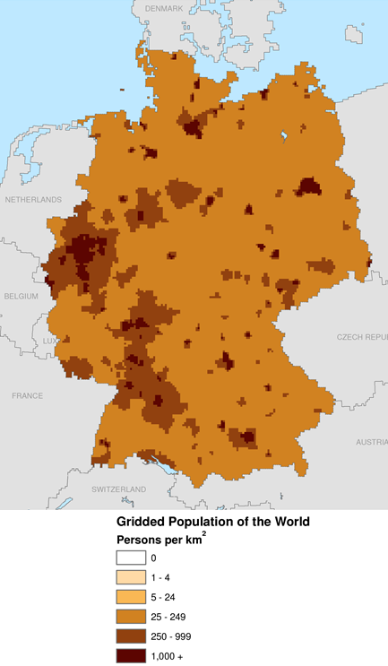
Where do most people live in Germany?
Notes:
Instructional Approach(s): The teacher should pose the question to the class. The teacher can ask for volunteers or call on specific students to respond to the question.

Slide 13
Ruhr
Valley
Most Germans
live in western Germany
The Ruhr Valley
in western German is the most densely populated area in the country filled with factories, cities, and towns.
Notes:
Instructional Approach(s): The teacher should present the information on the slide while the students summarize the important information on their notes.

Slide 14
Distributed Summarizing:
Use your graphic organizer to summarize the location, climate, natural resources, and population distribution of Germany.
Notes:
Instructional Approach(s): The students should use their notes and summarize the location, climate, natural resources, and where people live in Germany on their graphic organizer [linked on the curriculum map]

Slide 15
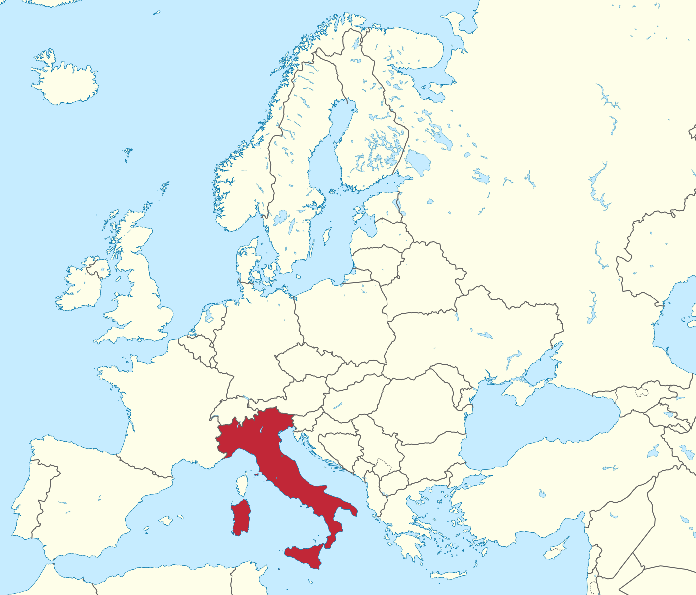
Italy
Notes:
Instructional Approach(s): Transition slide to the next country in Europe for discussion.

Slide 16
What are the advantages of Italy’s location?
Notes:
Instructional Approach(s): The teacher should pose the question to the class. The teacher can ask for volunteers or call on specific students to respond to the question.

Slide 17

Italy’s Location
Due to Italy’s
location, its climate
is moderate
Since Italy is close
to central Europe,
the northern cities
can trade easily with
other European countries.
Since most of Italy is surrounded by water,
it has many ports to ship and receive goods.
Notes:
Instructional Approach(s): The teacher should present the information on the slide while the students summarize the important information on their notes.

Slide 18
Italy’s
Climate
Italy
Italy’s climate is moderate with generally cool winters (colder in mountain regions) and warm summers.
Mountains cover about 70% of the country.
Agriculture is strongest in the northern part of the country.
Notes:
Instructional Approach(s): The teacher should present the information on the slide while the students summarize the important information on their notes.

Slide 19
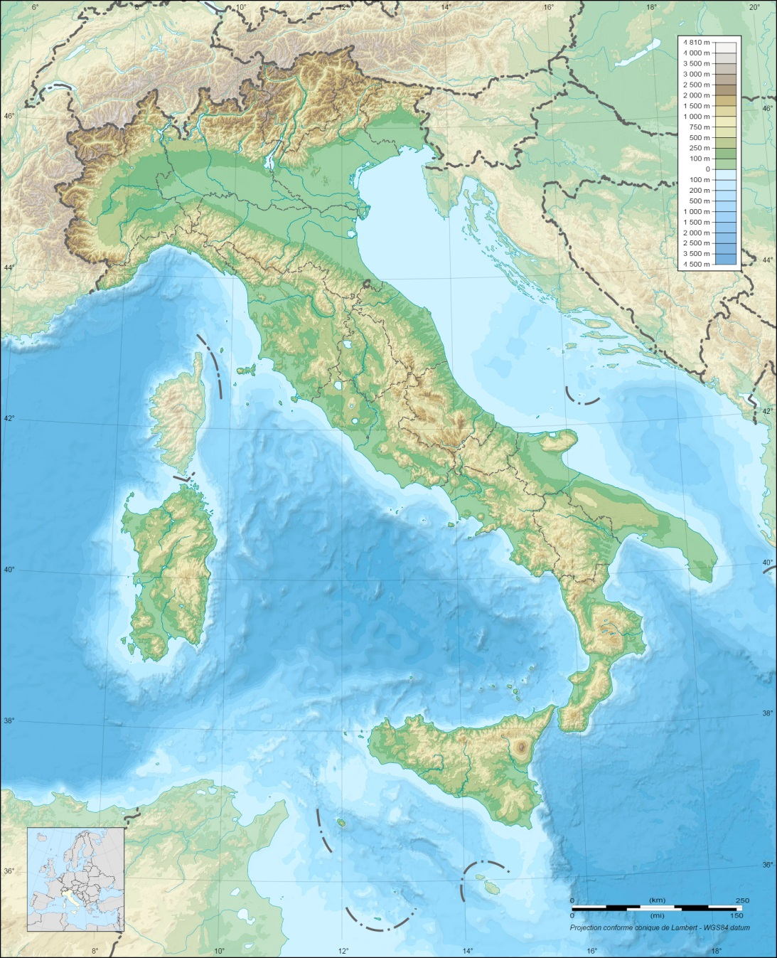
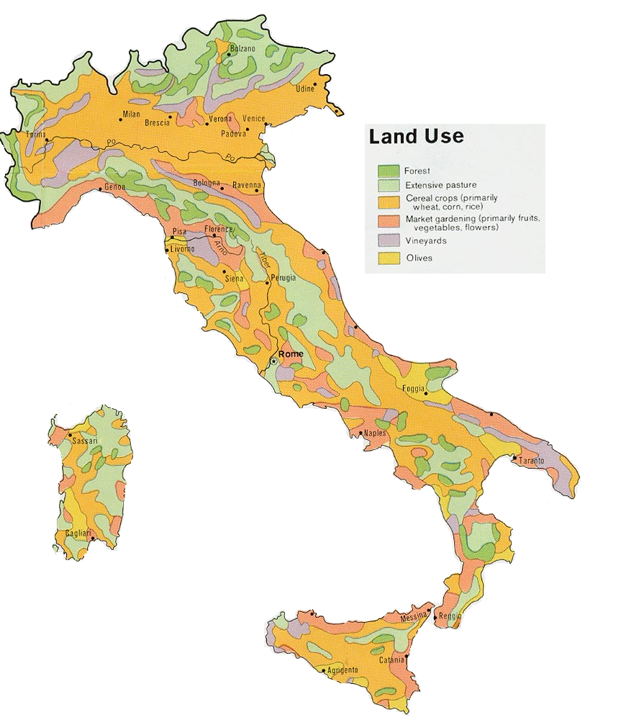
Take a look at the maps below.
What do you notice?
Notes:
Instructional Approach(s): The teacher should pose the question on the slide to the class. The teacher can ask for volunteers or call on specific students to answer the question. Discuss the question briefly with the class. Point out general observations such as: there are a lot of small chunks of land use so in most of the country there is not one main type of land use; there is a more sizable amount of land in the north used for “cereal” crops; discuss how the mountainous terrain might be the cause

Slide 20
Grapes grown in vineyards along the sides of mountains are Italy’s most valuable crop. Italian grapes have made Italy the largest wine producer in the world.
Notes:
Instructional Approach(s): The teacher should present the information on the slide while the students summarize the important information on their notes.

Slide 21
Notes:
Instructional Approach(s): The teacher should use the image on the slide to illustrate the country’s climate

Slide 22
Italy’s Natural Resources
Italy has few mineral resources
Italy has to import most of its raw materials for industry
Tourism is the most important industry in Italy. Why would tourists like to visit Italy?
Notes:
Instructional Approach(s): The teacher should present the information on the slide while the students summarize the important information on their notes.

Slide 23
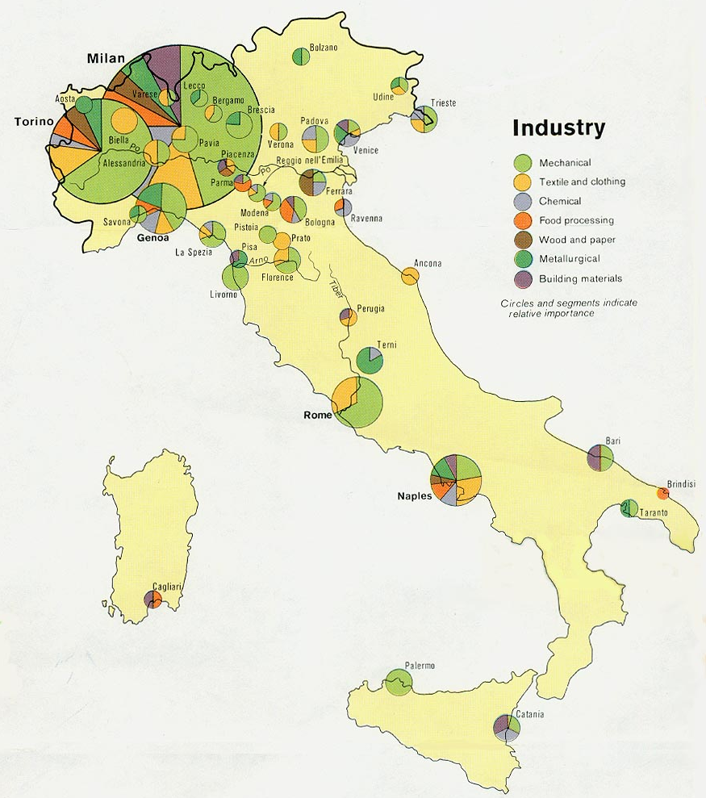
According to the
map to the right,
where is most
of Italy’s industry
located?
How does the
location of
these industries
affect the people
of Italy?
Notes:
Instructional Approach(s): The teacher should pose the questions to the class. Briefly discuss student responses.

Slide 24

Based on what you have learned already, where do you think most people live in Italy? Why?
Notes:
Instructional Approach(s): The teacher should pose the question to the class. The teacher can ask for volunteers or call on specific students to respond to the question.

Slide 25
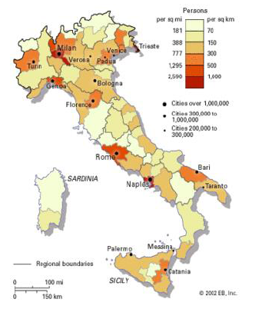
Most people live in the northern part of Italy where most of Italy’s industry and agriculture is located.
Notes:
Instructional Approach(s): The teacher should present the information on the slide while the students summarize the important information on their notes.

Slide 26
Distributed Summarizing:
Use your graphic organizer to summarize the location, climate, natural resources, and population distribution of Italy. Complete the question at the end.
Notes:
Instructional Approach(s): The students should use their notes and summarizer the location, climate, natural resources, and where people live in Russia on their graphic organizer [linked on the curriculum map]. Ask students to then complete the question on the end. The teacher may want to have students share their response with another student and then briefly share a few responses to the class.

