Slide 1
How do location, climate, and natural resources influence Europe and its people?
Standards:
SS6G10a. Compare how the location, climate, and natural resources of the United Kingdom and Russia affect where people live and how they trade.
SS6G10b. Compare how the location, climate, and natural resources of Germany and Italy affect where people live and how they trade.
Notes:
Instructional Approach(s): The teacher should introduce the essential question and the standards that align to the essential question.

Slide 2
There are many factors that impact where people live and how they trade. We are going to look at a few of these factors for four European countries.
Notes:
Instructional Approach(s): The teacher should present the information on the slide.

Slide 3
Compare the location, climate, and natural resources of the United Kingdom and Russia.
Notes:
Instructional Approach(s): Put students in groups of 2-3. Have groups compare different factors to share with the class. Small groups can be student selected or teacher selected (differentiated if needed). Students should not be given more than 2-3 minutes to make comparisons. The teacher should briefly discuss student responses.

Slide 4
Use your notes handout to record important information.
Notes:
Instructional Approach(s): The teacher should give each student a copy of the notes handout [linked on the curriculum map] to record important information during the lesson.

Slide 5
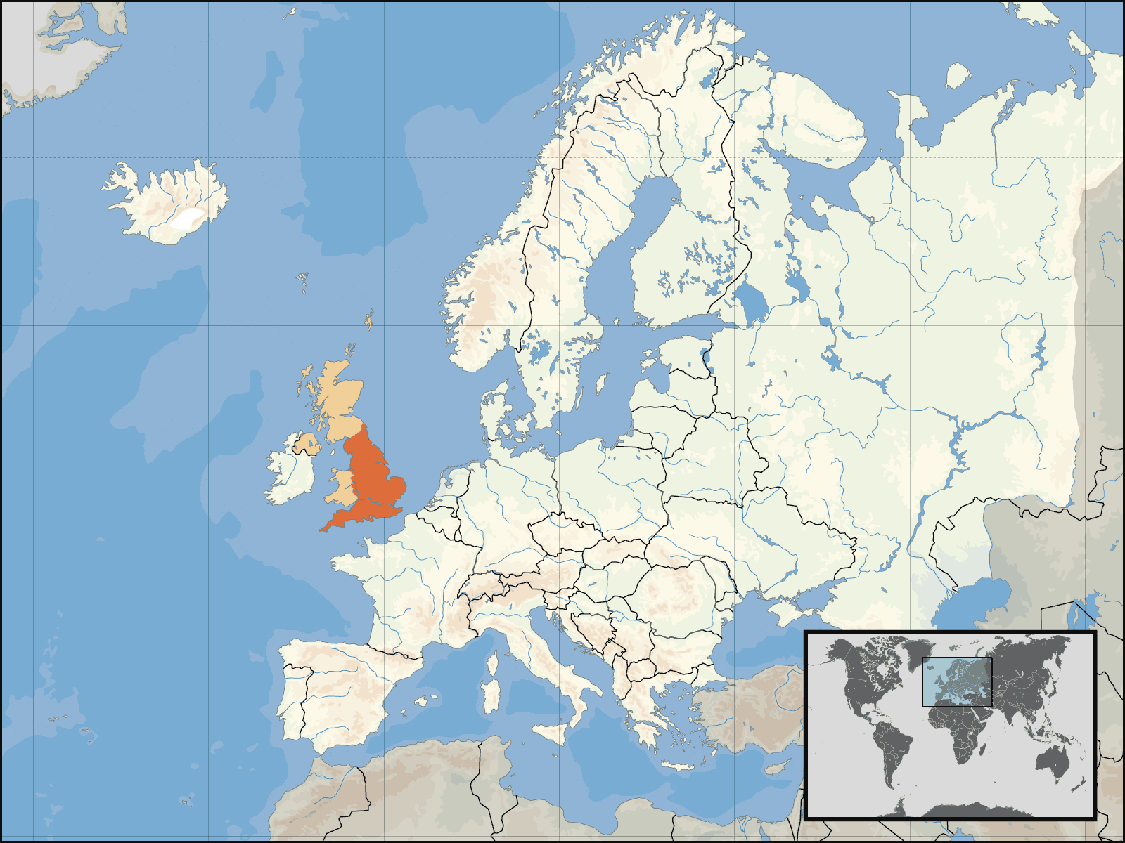
United Kingdom Great Britain (England, Scotland, and Wales) and Northern Ireland
Notes:
Instructional Approach(s): The teacher should present the information on the slide.

Slide 6
What are the advantages and disadvantages of the United Kingdom’s location?
Notes:
Instructional Approach(s): The teacher should pose the question to the class. The teacher can ask for volunteers or call on specific students to respond to the question. The teacher should not spend more than 2-3 minutes discussing the question on the slide.

Slide 7
United Kingdom’s Location
The United Kingdom is surrounded by water which impacts the way in which it trades with other countries. How?
The United Kingdom’s location is a major influence on its climate [this will be discussed more in-depth]
The primary type of military used is also influenced by the United Kingdom’s location. Why?
Notes:
Instructional Approach(s): The teacher should present the information on the slide while the students summarize the important information on their notes.

Slide 8
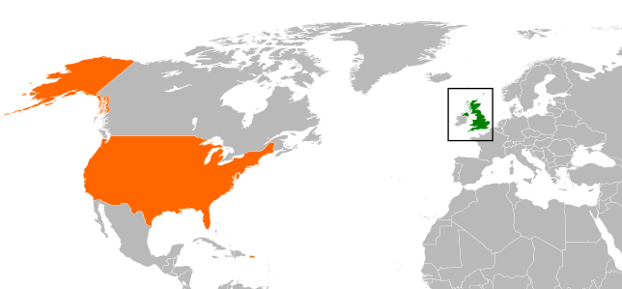
Location and Climate
What would be your guess about the climate of the United Kingdom?
United
Kingdom
Canada
Central
America
You are here
Africa
Has anyone traveled far up North? What was the weather like? What do you know about the climate of Canada?
Notes:
Instructional Approach(s): The teacher should pose the question(s) on the slide. Do not spend more than 5 minutes discussing the questions. The intent of the slide is to activate student prior knowledge and get them to infer about the climate of the United Kingdom versus the actual climate.

Slide 9
Actually, the climate of the United Kingdom and many other European countries is Moderate.
What does that mean?
Synonyms for Moderate: fair, mild, medium, temperate
If the United Kingdom is on a similar latitude as Canada, how is its climate moderate?
Notes:
Instructional Approach(s): The teacher should present the information on the slide.

Slide 10
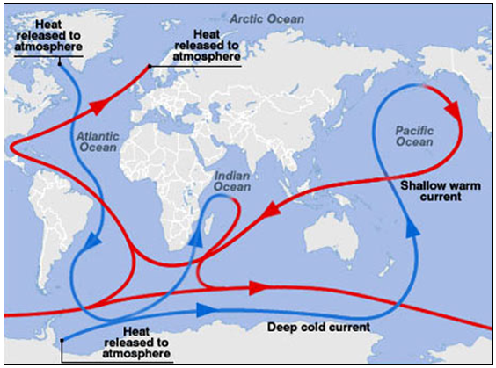
Gulf Steam’s affect on Climate
http://www.pbslearningmedia.org/resource/ttv10.sci.ess.watcyc.currents/the-role-of-ocean-currents-in-climate/
Notes:
Instructional Approach(s): The teacher should present the information on the slide and show the link to illustrate the Gulf Stream’s affect on climate.

Slide 11
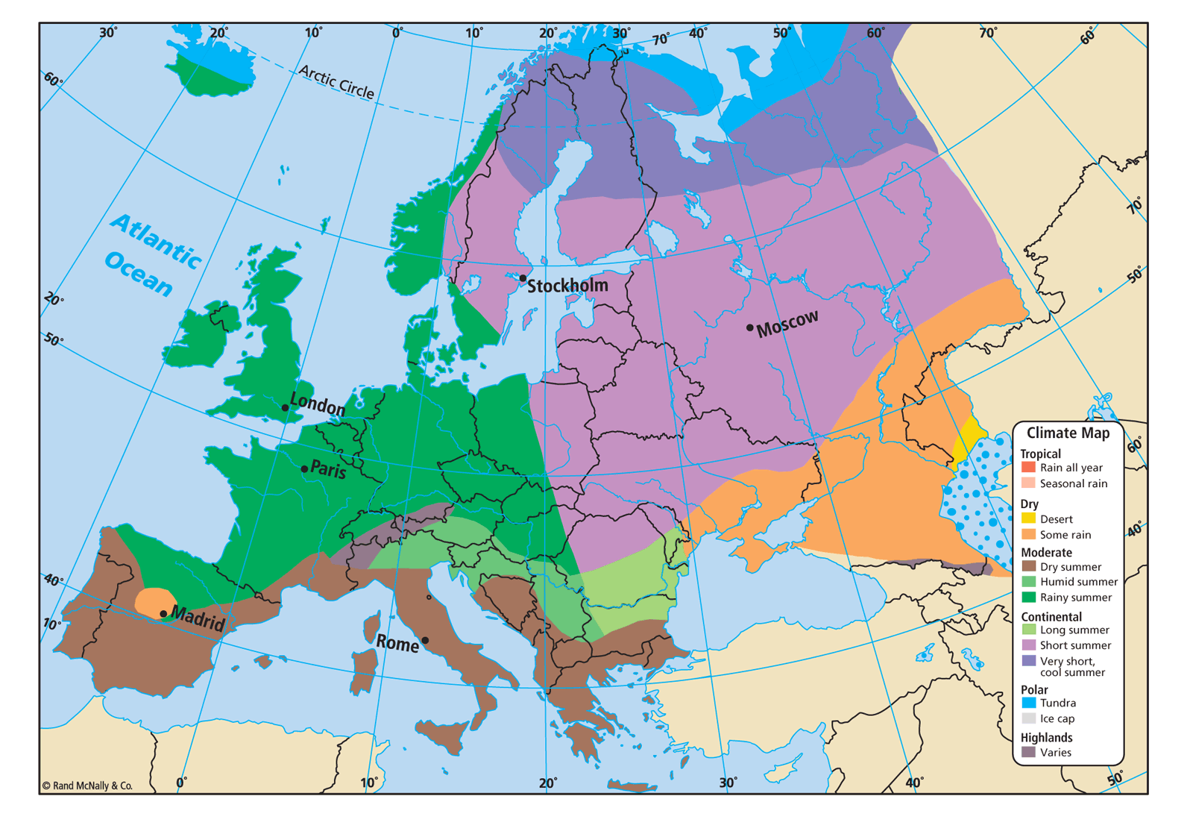
The United Kingdom’s climate has mild temperatures, and it has moist weather with plenty of rain is good for crops.
Notes:
Instructional Approach(s): The teacher should present the information on the slide while the students summarize the important information on their notes.

Slide 12
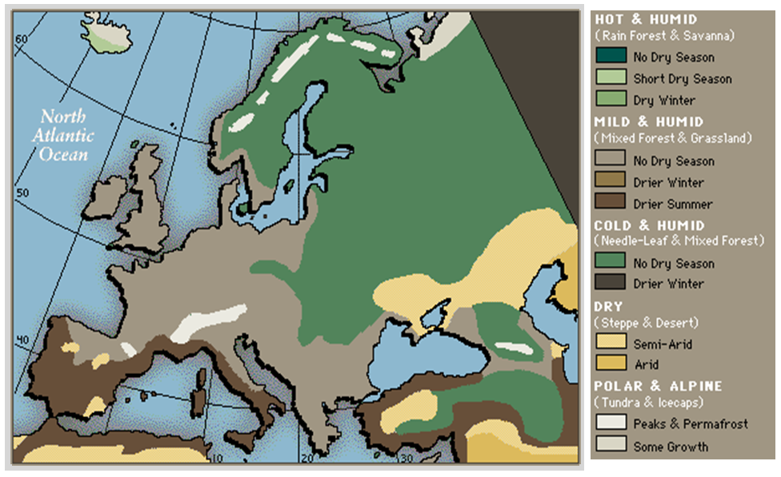
Notes:
Instructional Approach(s): The teacher should use the image on the slide to illustrate the country’s climate

Slide 13
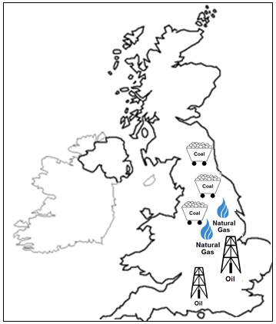
Natural Resources of the United Kingdom
Notes:
Instructional Approach(s): The teacher should present the information on the slide while the students record the important information on their notes.

Slide 14
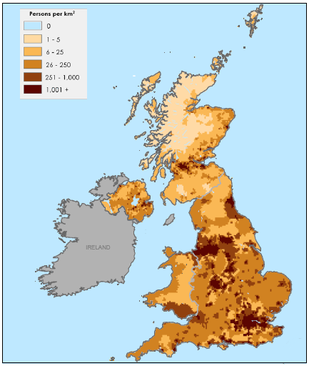
Where do people live in the United Kingdom?
Notes:
Instructional Approach(s): The teacher should pose the question to the class. The teacher can ask for volunteers or call on specific students to respond to the question.

Slide 15
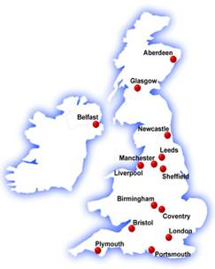
Compare the diagram showing the United Kingdom’s major cities with the population density map. Where do most people live?
Major Cities in the
United Kingdom
Notes:
Instructional Approach(s): The teacher should pose the question to the class and ask for volunteers or call on specific students to respond. Click to the next slide to discuss the specifics of where people live.

Slide 16
People in the United Kingdom
Most people live in urban (city) areas
There are some areas of farming, but Great Britain has to import one-third of its food.
Great Britain’s capital, London, is a world center for trade and banking
Great Britain also has manufacturing industries such as iron and steel and electronics that affect where people live.
Notes:
Instructional Approach(s): The teacher should present the information on the slide while the students record the important information on their notes.

Slide 17
Distributed Summarizing: Use your graphic organizer to summarize the location, climate, natural resources, and population distribution of the United Kingdom.
Notes:
Instructional Approach(s): The students should use their notes and summarize the location, climate, natural resources, and where people live in the United Kingdom on their graphic organizer [linked on the curriculum map]

Slide 18
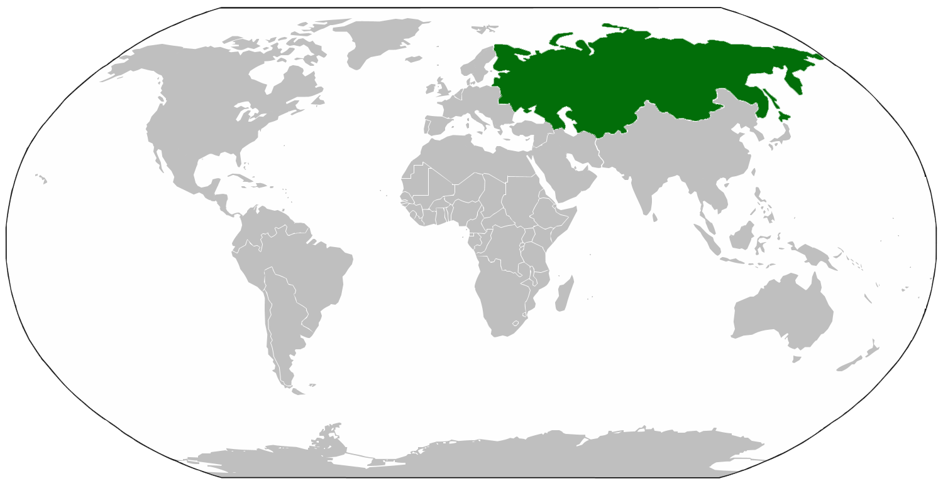
Russia
Notes:
Instructional Approach(s): Transition slide moving to the next country in Europe

Slide 19
What are the advantages and disadvantages of Russia’s location?
Notes:
Instructional Approach(s): The teacher should pose the question to the class. The teacher can ask for volunteers or call on specific students to respond to the question. The teacher should not spend more than 2-3 minutes discussing the question on the slide.

Slide 20
Russia’s Location
The Gulf Stream does not affect Russia; therefore, due to its location, Russia’s climate is severe in many areas.
In some areas it is so cold that the soil is permanently frozen which hinders farming and economic development.
Russia is unfavorably located in relation to major sea lanes of the world which further inhibits trade.
Notes:
Instructional Approach(s): The teacher should present the information on the slide while the students summarize the important information on their notes.

Slide 21
Russia’s
Climate
Russia
Russia’s climate is very cold because it is located near the Arctic Ocean.
Russia does not get a lot of rainfall.
Only about 10% of Russia’s total land is suitable for agriculture.
Notes:
Instructional Approach(s): The teacher should present the information on the slide while the students summarize the important information on their notes.

Slide 22
Notes:
Instructional Approach(s): The teacher should use the image on the slide to illustrate the country’s climate

Slide 23
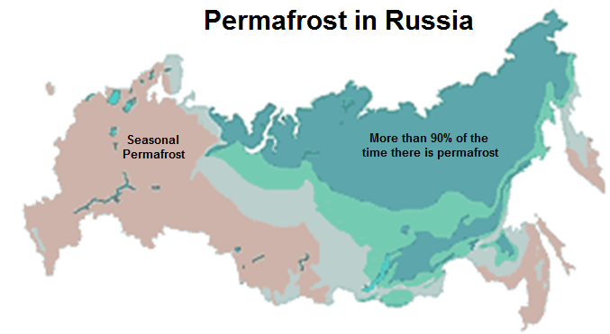
Russia’s Climate
Permafrost is a thick layer of soil that remains frozen. The map above shows the extent of permafrost in Russia.
Notes:
Instructional Approach(s): The teacher should present the information on the slide while the students summarize the important information on their notes.

Slide 24
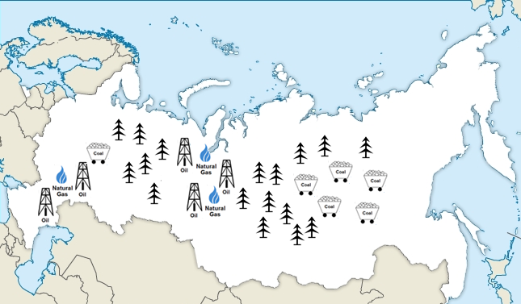
Russia’s Natural Resources
Notes:
Instructional Approach(s): The teacher should use the image on the slide to illustrate Russia’s natural resources while the students record the information on their notes.

Slide 25
The Challenges of Russia’s Natural Resources
Russia is rich in mineral resources, with huge deposits of coal, oil, and natural gas, as well as massive forests. So, what’s the problem?
It is difficult and expensive to harvest and transport these resources because of the harsh climate and remote locations.
The lack of access to natural resources due to climate, terrain, and distance hinders trade.
Russia’s mining, manufacturing, and fishing industries are fueled by the country’s natural resources.
Many goods are transported by railroad because rivers and major ports are blocked by ice in the winter.
Notes:
Instructional Approach(s): The teacher should present the information on the slide while the students summarize the important information on their notes.

Slide 26
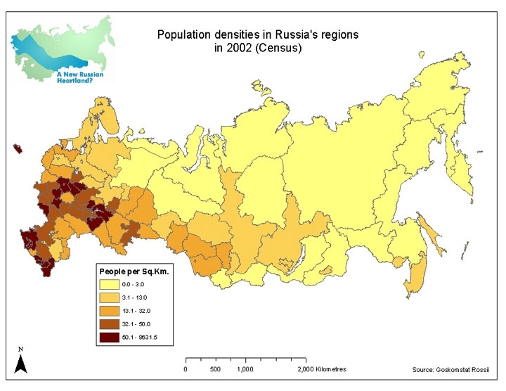
Where do most people live in Russia?
Why?
Notes:
Instructional Approach(s): The teacher should pose the question to the class. The teacher can ask for volunteers or call on specific students to respond to the question.

Slide 27
Where do most people live in Russia? Why?
Most citizens live in western Russia on the European Plain
Russia’s major cities, farms, grazing land for livestock, and the country’s warmest temperatures are located in western Russia.
Notes:
Instructional Approach(s): The teacher should present the information on the slide while the students summarize the important information on their notes.

Slide 28
Distributed Summarizing: Use your graphic organizer to summarize the location, climate, natural resources, and population distribution of Russia. Complete the question at the end.
Notes:
Instructional Approach(s): The students should use their notes and summarize the location, climate, natural resources, and where people live in Russia on their graphic organizer [linked on the curriculum map]. Ask students to then complete the question on the end. The teacher may want to have students share their response with another student and then briefly share a few responses to the class.

